Slide 1
Object Oriented Programming Lecture -6
Chapter 14, D.S. Malik, C++ Programming, 5th edition
Chapter 8, Dietel & Dietel, C++ how to Program, 7th edition
Object oriented Programming
Spring 2024

Slide 2
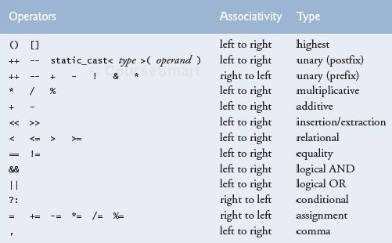
Precedence rules

Slide 3
Example
#include <iostream>
using namespace std;
int main()
{
int x[4]={1,2,3,4};
int *p=x,y,z;
y=*++p;
z=*p++;
cout<<"\ny="<<y;
cout<<"\nz="<<z;
cout<<"\n*p="<<*p;
return 0;
}
C:\MinGW\bin>g++ a.cpp -o a.exe
C:\MinGW\bin>a
y=2
z=2
*p=3
C:\MinGW\bin>

Slide 4
Pointers & Arrays (Example)
void PrintArray(int Array[],int Size)
{
for (int i=0;i<Size;++i)
cout << Array[i] << " ";
cout << endl;
}
int main()
{
int arr[5] = {1,2,3,4,5};
int *ptr = arr; //which array element does ptr point to
//printing first time
PrintArray(arr,5);
ptr = ptr + 1; //where will ptr point now
*(ptr-1) = 10*ptr[-1]; //which arr element will be changed
*(ptr+2) = 10* *(ptr+2); //which arr element will be changed
//printing second time
PrintArray(arr,5);
ptr = ptr +2; //where is ptr now
ptr[-2] = ptr[-2] * 10; //what will this change?
//printing third time
PrintArray(arr,5);
return 0;
}
1 2 3 4 5
10 2 3 40 5
10 20 3 40 5

Slide 5
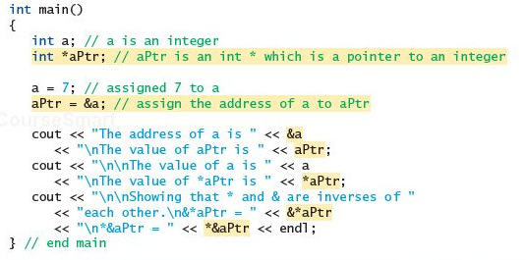
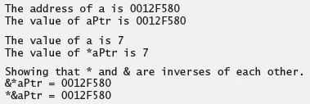
& and * are inverse of each other

Slide 6
The Correct Place for “const”
pointer value cannot be changed now, i.e., we cannot do this:
x=&g;
int y=2, g=3;
int * const x=&y;
const int * z;
z=&y;
The value of the variable pointed by z cannot be changed through pointer i.e., we cannot do this
*z=32; but we can do this: y=32; directly

Slide 7
Functions and Pointers

Slide 8
3 ways to pass arguments to a function
Pass by value
Pass by reference with reference arguments
Pass by reference with pointer arguments
Function call by passing address
Function call by passing a pointer

Slide 9
Argument pass by reference
void centimize(double&); //prototype
int main()
{
double var = 10.0; //var has value of 10 inches
cout << “var = “ << var << “ inches” << endl;
centimize(var); //change var to centimeters
cout << “var = “ << var << “ centimeters” << endl;
return 0;
}
//--------------------------------------------------------------
void centimize(double& v)
{
v =v* 2.54; //v is the same as var
}
OUTPUT:
var = 10 inches
var = 25.4 centimeters
var
10
0x1234
v is an alias of var, i.e., same memory location has two names
var
25.4
v
0x1234

Slide 10
Using Pointers in function arguments
void centimize(double*); //prototype
int main()
{
double var = 10.0; //var has value of 10 inches
cout << “var = “ << var << “ inches” << endl;
centimize(&var); //change var to centimeters
cout << “var = “ << var << “ centimeters” << endl;
return 0;
}
//--------------------------------------------------------------
void centimize(double* ptrd)
{
*ptrd = *ptrd * 2.54; //*ptrd is the same as var
}
OUTPUT:
var = 10 inches
var = 25.4 centimeters
This is an example of Function call by passing address

Slide 11
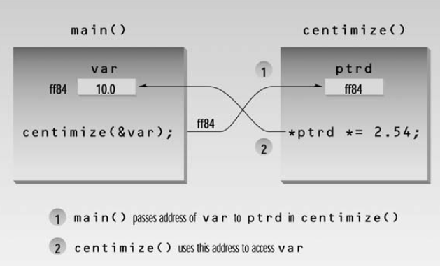

Slide 12
Another implementation
void centimize(double*); //prototype
int main()
{
double var = 10.0; //var has value of 10 inches
cout << “var = “ << var << “ inches” << endl;
Double * q= &var;
Centimize(q);
cout << “var = “ << var << “ centimeters” << endl;
return 0;
}
//--------------------------------------------------------------
void centimize(double* ptrd)
{
*ptrd = *ptrd * 2.54; //*ptrd is the same as var
}
OUTPUT:
var = 10 inches
var = 25.4 centimeters
This is an example of Function call by passing pointer

Slide 13
Function call by passing address
void Increment(int *x)
{
*x = *x+1
}
void CallIncrement()
{
int a=10;
Increment(&a);
}
Increment x
x and a are two different variables
x has the address of a
CallIncrement a
Slides from Dr. Mahreen Saeed’s Lecture

Slide 14
New implementation::
Function call by passing a pointer
void Increment(int *x)
{
*x = *x+1
}
void CallIncrement()
{
int a=10;
Increment(&a);
}
void Increment(int *x)
{
*x = *x+1
}
void CallIncrement()
{
int a=10;
int * p=&a;
Increment(p);
}
Previous implementation::
Function call by passing address
This is also called ::
passing pointer by value
Increment
x
&a
CallIncrement a
p
&a
10
Slides from Dr. Mahreen Saeed’s Lecture

Slide 15
exercise

Slide 16
void quiteSimple(int *p, int *q)
{ *p = *p+1;
*q = *q + 5;
q = p;
(*p)++;
*q = *p + *q;
}
 | a | b | p | *p | q | *q
int a=0,b=0; | 0 | 0 | ? | ? | ? | ?
int *p=NULL,*q=NULL; | 0 | 0 | N | ? | N | ?
p=&a; q=&b;*p = 5; *q = 4; | 5 | 4 | &a | 5 | &b | 4
quiteSimple(p,q); | 14 | 9 | &a | 14 | &a | 14

Slide 17
void quiteSimple(int *p1, int *q1)
{ *p1 = *p1+1;
*q1 = *q1 + 5;
q1 = p1;
(*p1)++;
*q1 = *p1 + *q1;
}
 | a | b | p | *p | q | *q
int a=0,b=0; | 0 | 0 | ? | ? | ? | ?
int *p=NULL,*q=NULL; | 0 | 0 | N | ? | N | ?
p=&a; q=&b;*p = 5; *q = 4; | 5 | 4 | &a | 5 | &b | 4
quiteSimple(p,q); | 14 | 9 | &a | 14 | &b | 9

Slide 18
Passing pointers to function
By value
By reference

Slide 19
Passing pointer to functions (by value)
#include <iostream>
using namespace std;
void Swap(int * a, int * b)
{
int *temp;
temp=a;
a=b;
b=temp;
}
int main()
{
int x=2, y=4;
int *p, *q;
p=&x;
q=&y;
Swap(p,q);
cout<<*p<<" "<<*q;
return 0;
}
a
0xad1234
p
0xad1234
x
2
0xff457
0xad1234
0xed100
b
0xae2345
q
0xae2345
y
4
0xef250
0xff459
0xae2345
p
0xad1234
x
2
0xff457
0xad1234
q
0xae2345
y
4
0xff459
0xae2345

Slide 20
output
Tooba@2ba /c/mingw/bin
$ g++ swap_pointers.cpp -o a.exe
Tooba@2ba /c/mingw/bin
$ a
Before Swap() call
2 4
After Swap() call
2 4
Tooba@2ba /c/mingw/bin
$

